Slide 1


1 Scouts against malaria
Of the various tropical diseases, malaria is
the most common.
It results world wide in some 200 million people
being infected and more than 600,000 deaths
mainly amongst children under the age of
5 years of age each year
So imagine loosing a brother or sister at this age.

Slide 2

2 Why is malaria so effective
Malaria is so wide spread because
there is no universal vaccine yet
available unlike other diseases
like yellow fever or polio
Symptoms include a high fever,
and inability to retain loss of body
Fluids which is why young people
are so affected Sustainable development
goal #3
.

Slide 3
3 How is malaria spread?
Malaria is spread by mosquitos.
There are 15,000 mosquitos for
every human so very numerous
Mosquitos are major pollinators
as they feed on plants and so are
Important in growing crops
Only 5 species spread malaria of
which the anopheles mosquito is
the most significant.

Slide 4

4 Why do mosquitos bite?
Mosquitos bite because the female
mosquito needs to draw blood
from which she extracts the
protein to develop her larvae.
In drawing blood, she injects in turn
into the blood stream a parasite called
a plasmodium which attacks the blood
cells in the liver, one of the bodies organs .

Slide 5

5 In what countries do mosquitos thrive?
Mosquitos thrive under hot and
wet climate conditions hence the
reason why it is a tropical disease.
However not all countries within the
tropics are hot and wet. Some are
very dry like the Sahara desert and
some are very mountainous like
Ethiopia which is very cold at night.

Slide 6
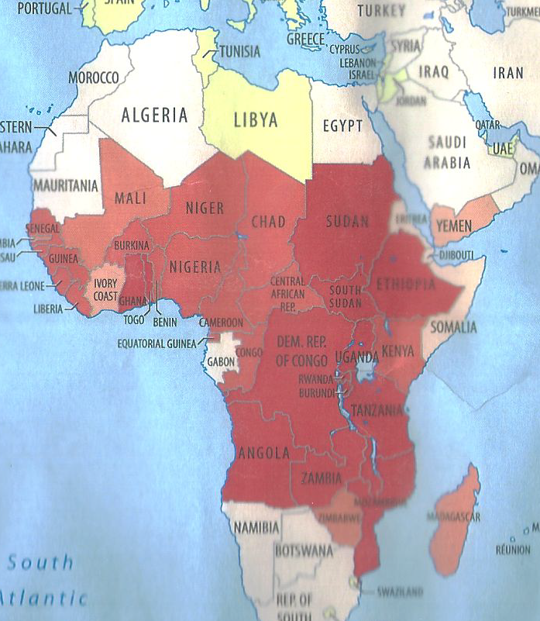
6 Where malaria is found in Africa

Slide 7
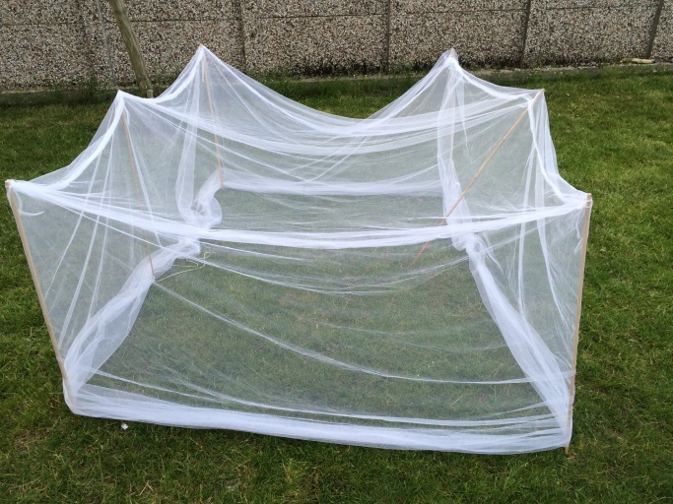
7 How to prevent being bitten?
The anopheles mosquito which is
the greatest carrier of the parasite
is active from dusk to dawn.
So mosquitos can and do bite when
you are asleep.
So the most effective way to prevent
being bitten when sleeping is to sleep
under a bed net.
.

Slide 8
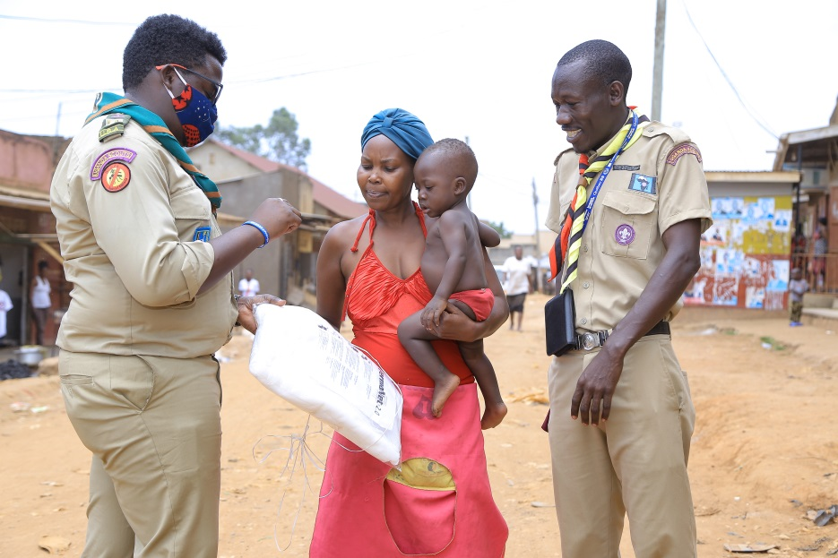
8 Insecticide treated bed nets
If the bed net is treated with an
insecticide then a mosquito will
be killed if it tries to bite through
the net.
However only half of the 200 million
people in Africa are currently
protected by sleeping under a
bed net

Slide 9
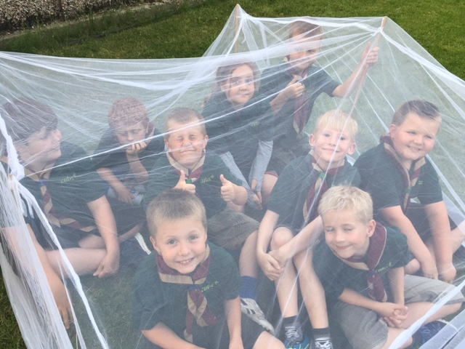
9 What can UK Scouts do?
Learn about the illness and
how it can be prevented
Raise funds on average
£5 per person which will pay
for buying & distributing a bed
net
Send the funds to Scout
Associations in Africa
Earn the SAM badge

Slide 10
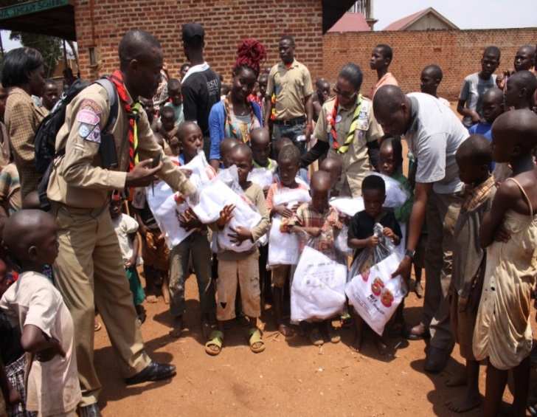
10 What can African Scouts do?
Learn about the illness and
how it can be prevented
Use funds raised by UK Scouts
to buy insecticide treated bed nets
Work with local health officials,
to educate communities in the use
of these nets
Help distribute and erect them

Slide 11
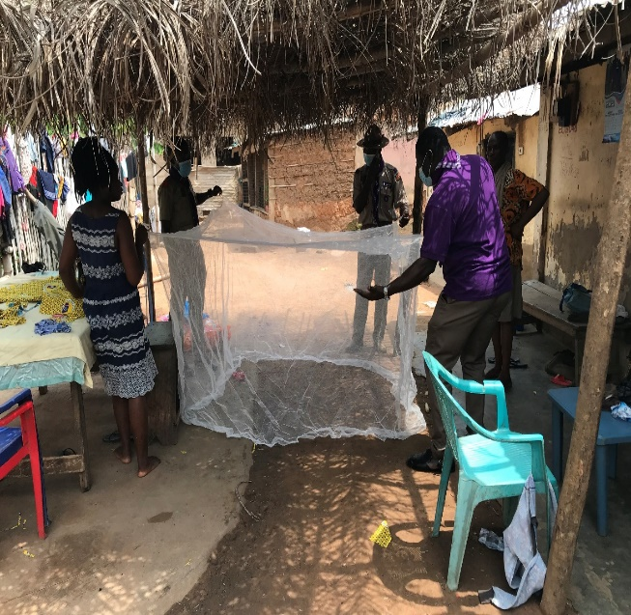
11 What else can African Scouts do?
Explain symptoms if bitten,
and why they need to seek help
from the nearest clinic which
could be some distance away
to begin treatment
Ensure that any stagnant
sources of water are drained so
that mosquitos cannot breed

Slide 12
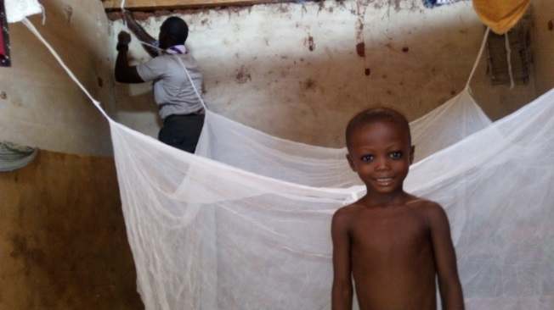
12 Ensuring healthy lives
’.

